Slide 1
Multi User Communications System
Manpreet Singh, Amna Tiwana, Umaimah Syed,
Bhavan Patel

Slide 2
Project Introduction
Topic: Multiuser Communication System
Provides a service for its users allowing them to communicate through the internet one on one chat.

Slide 3
Requirements
Functional Requirements
Common Requirements
Account Requirements
User Requirements
Client Requirements
Server Requirements
Delete Requirements
GUI Requirements
Message Requirements
Internal Requirements
Non- Functional Requirements
Security and Privacy Requirements
Performance Requirements

Slide 4
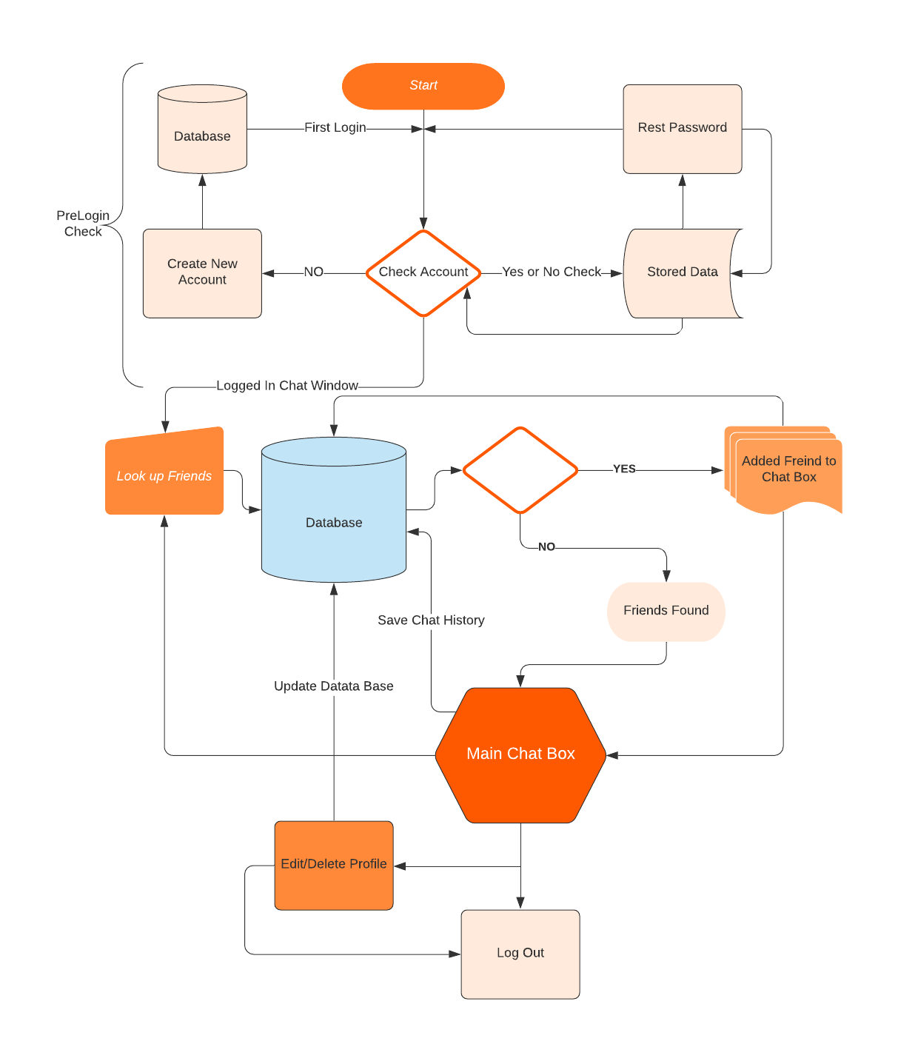
Design
-First Design Idea- Flowchart
-We didn't have many classes and were not sure which direction to go we put all most everything in Client and Server Side but later realized we needed separate the new account and gui classes along with maybe different status class.
-User use case flow chart

Slide 5
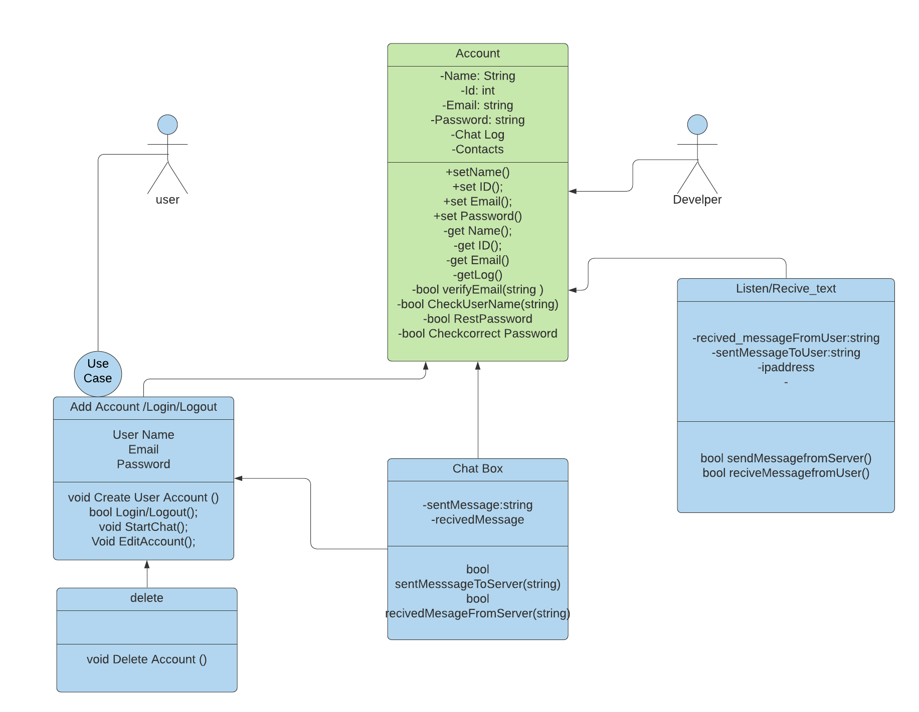
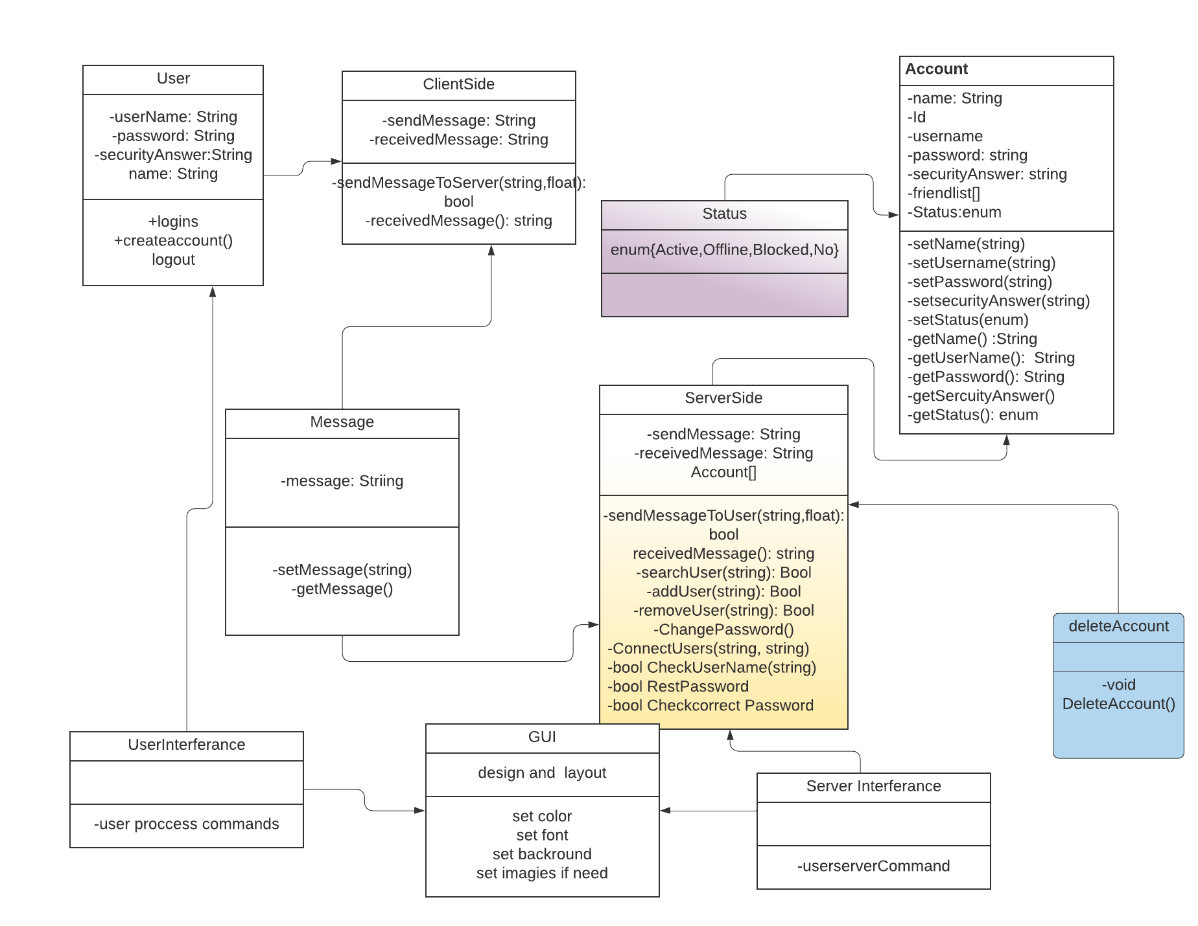
Before After

Slide 6
Implementation
ClientSide Class: The ClientSide class provide the socket to client to make the connection with the Server. After establishing the connection, Client will be able to Login, Chat and logout with the command.
ServerSide Classes: The SeverSide Class accepts the multiple clients connection, and Create the new thread every time new Client connects to the server to provide the all features of the Chat System. Also, it will connect the two clients to start and run the chat.
AccountClass and AccountHolder Class are connected together, in a way that Account Holder class is storing all the account details of users.

Slide 7
Other Classes as Implementation
Message.class : Create the object of the message and pass that object between the Server and Client.

Slide 8
Development Summary & Observations
Difficult task
Coding
Git
Java
Different opinions
Research

Slide 9
Demonstration
Demonstrate the program on Eclipse….

Slide 10
THE END
Thank you Professor Smith and fellow classmates...

